Slide 1
Math Preparation Vectors
Vectors

Slide 2
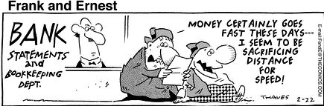
Vectors

Slide 3
Vectors
Vector quantities
Physical quantities that have both numerical and directional properties
Mathematical operations of vectors in this chapter
Addition
Subtraction
Multiplication
Dot Product
Cross Product

Slide 4
Coordinate Systems
Used to describe the position of a point in space
Common coordinate systems are:
Cartesian
Polar

Slide 5
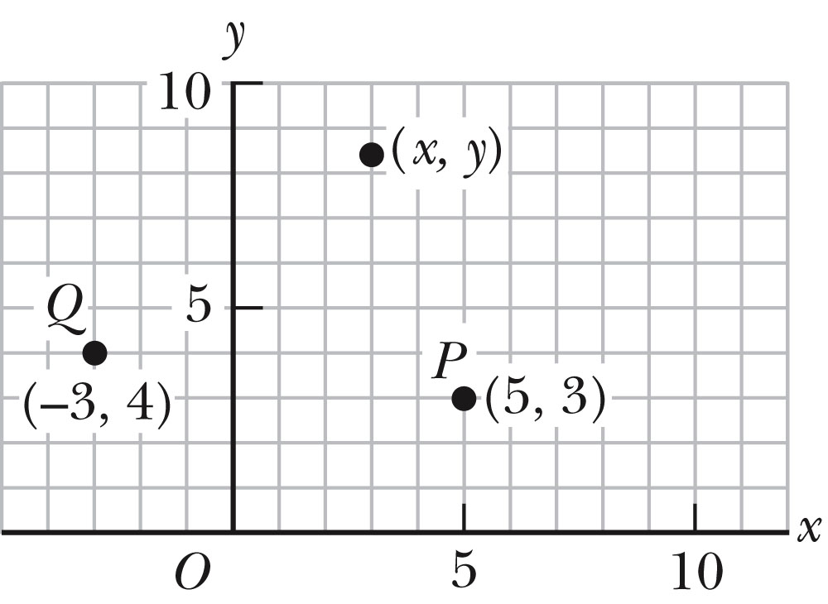
Cartesian Coordinate System
Also called rectangular coordinate system
x- and y- axes intersect at the origin
Points are labeled (x,y)

Slide 6
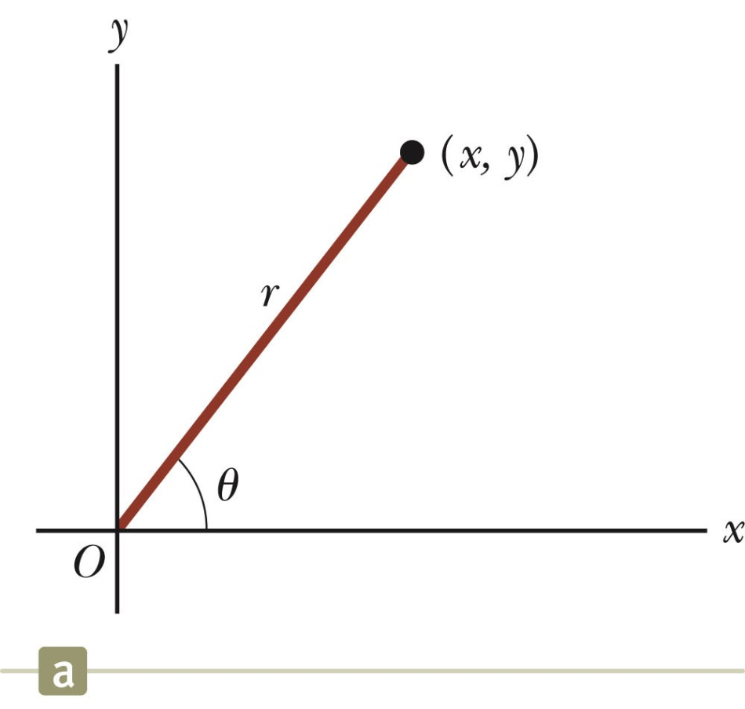
Polar Coordinate System
Origin and reference line are noted
Point is distance r from the origin in the direction of angle θ, ccw from reference line
The reference line is often the x-axis.
Points are labeled (r,θ)

Slide 7
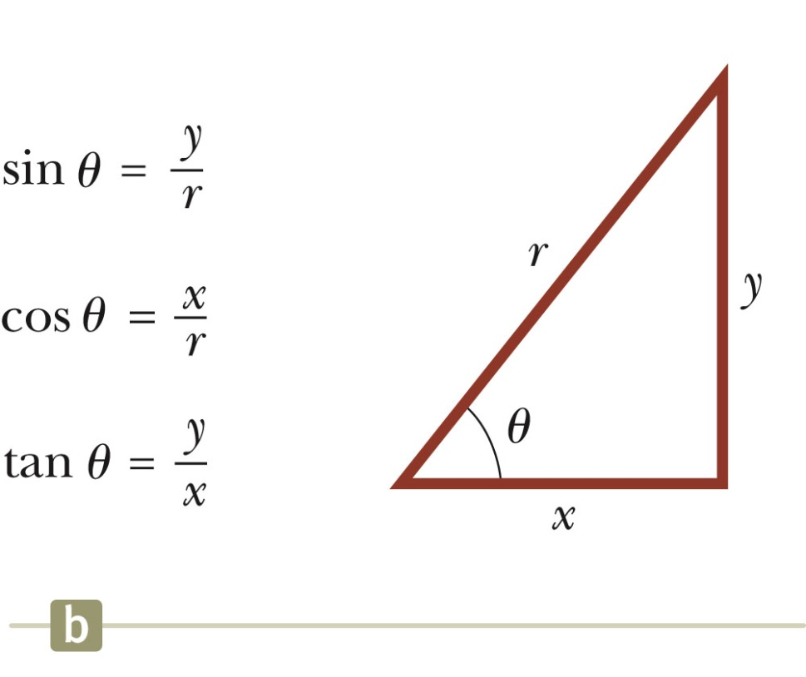
Polar to Cartesian Coordinates
Based on forming a right triangle from r and θ
x = r cos θ
y = r sin θ
If the Cartesian coordinates are known:

Slide 8
Vectors and Scalars
A scalar quantity is completely specified by a single value with an appropriate unit and has no direction.
Many are always positive
Some may be positive or negative
Rules for ordinary arithmetic are used to manipulate scalar quantities.
A vector quantity is completely described by a number and appropriate units plus a direction.

Slide 9
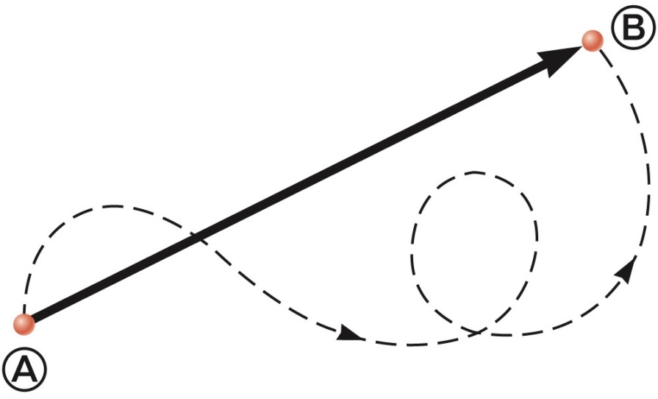
Vector Example
A particle travels from A to B along the path shown by the broken line.
This is the distance traveled and is a scalar.
The displacement is the solid line from A to B
The displacement is independent of the path taken between the two points.
Displacement is a vector.

Slide 10
Vector Notation
Text uses bold with arrow to denote a vector:
Also used for printing is simple bold print: A
When dealing with just the magnitude of a vector in print, an italic letter will be used: A or | |
The magnitude of the vector has physical units.
The magnitude of a vector is always a positive number.
When handwritten, use an arrow:

Slide 11
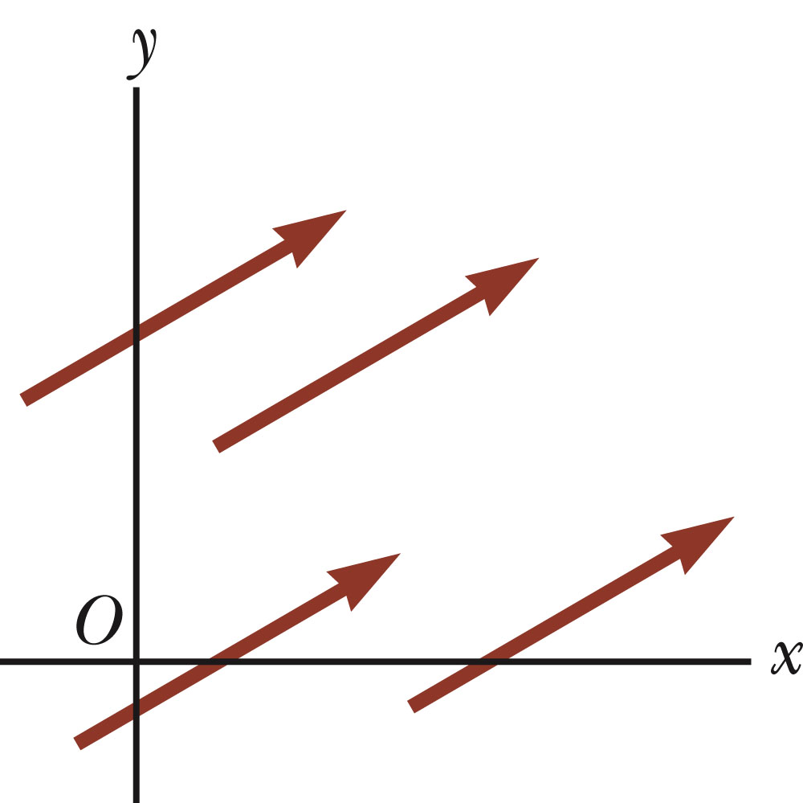
Equality of Two Vectors
Two vectors are equal if they have the same magnitude and the same direction.
if A = B and they point along parallel lines
All of the vectors shown are equal.
Allows a vector to be moved to a position parallel to itself

Slide 12
Adding Vectors
Vector addition is very different from adding scalar quantities.
When adding vectors, their directions must be taken into account.
Units must be the same
Graphical Methods
Use scale drawings
Algebraic Methods
More convenient

Slide 13
Adding Vectors Graphically
Choose a scale.
Draw the first vector, , with the appropriate length and in the direction specified, with respect to a coordinate system.
Draw the next vector with the appropriate length and in the direction specified, with respect to a coordinate system whose origin is the end of vector and parallel to the coordinate system used for .

Slide 14
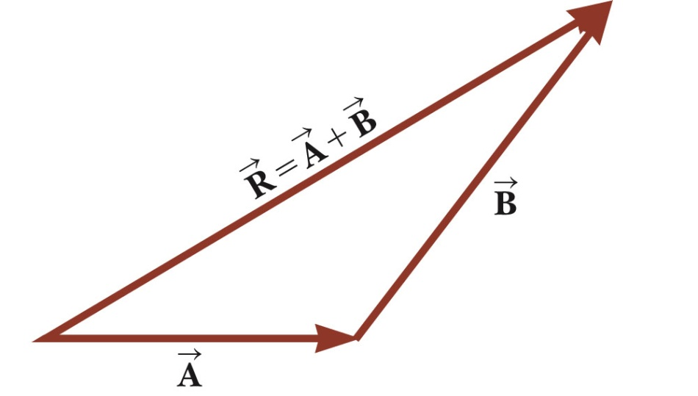
Adding Vectors Graphically, cont.
Continue drawing the vectors “tip-to-tail” or “head-to-tail”.
The resultant is drawn from the origin of the first vector to the end of the last vector.
Measure the length of the resultant and its angle.
Use the scale factor to convert length to actual magnitude.

Slide 15
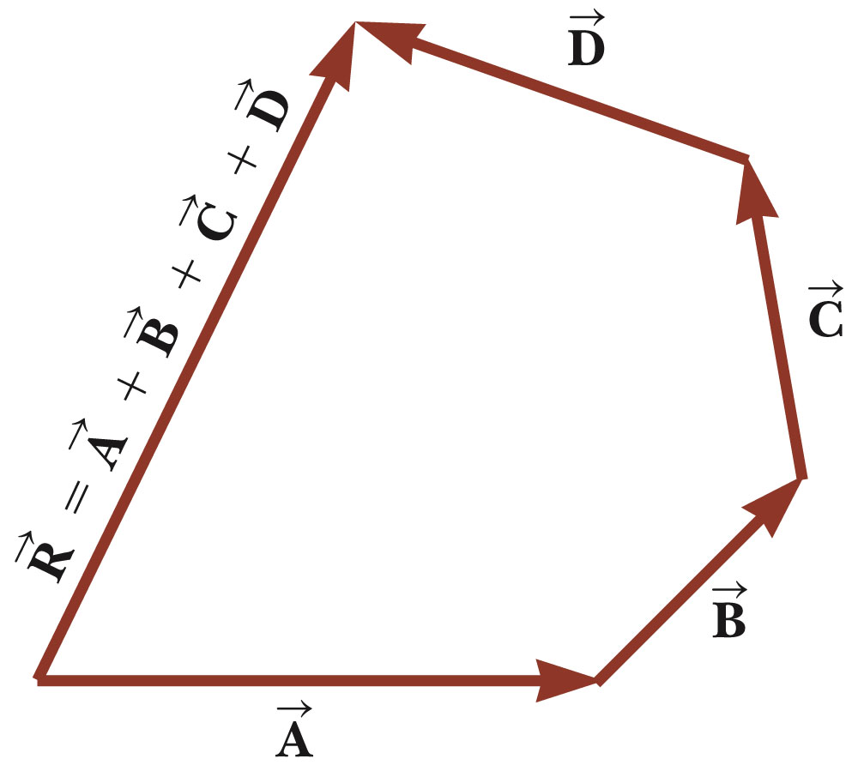
Adding Vectors Graphically, final
When you have many vectors, just keep repeating the process until all are included.
The resultant is still drawn from the tail of the first vector to the tip of the last vector.

Slide 16
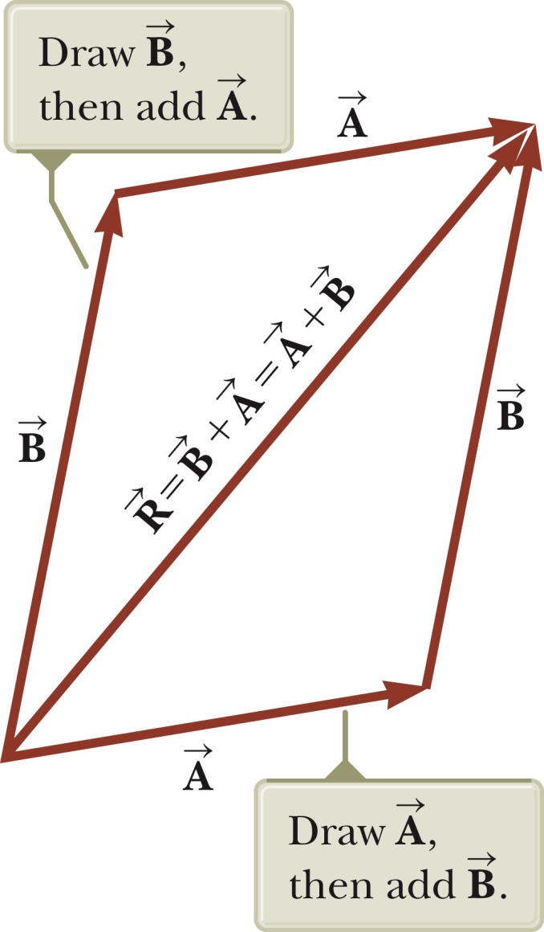
Adding Vectors, Rules
When two vectors are added, the sum is independent of the order of the addition.
This is the Commutative Law of Addition.

Slide 17
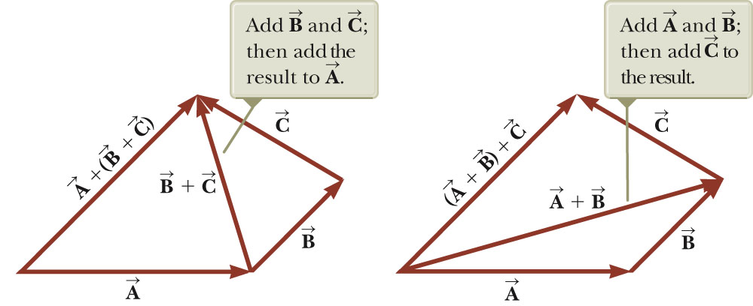
Adding Vectors, Rules cont.
When adding three or more vectors, their sum is independent of the way in which the individual vectors are grouped.
This is called the Associative Property of Addition.

Slide 18
Adding Vectors, Rules final
When adding vectors, all of the vectors must have the same units.
All of the vectors must be of the same type of quantity.
For example, you cannot add a displacement to a velocity.

Slide 19
Negative of a Vector
The negative of a vector is defined as the vector that, when added to the original vector, gives a resultant of zero.
Represented as
The negative of the vector will have the same magnitude, but point in the opposite direction.

Slide 20
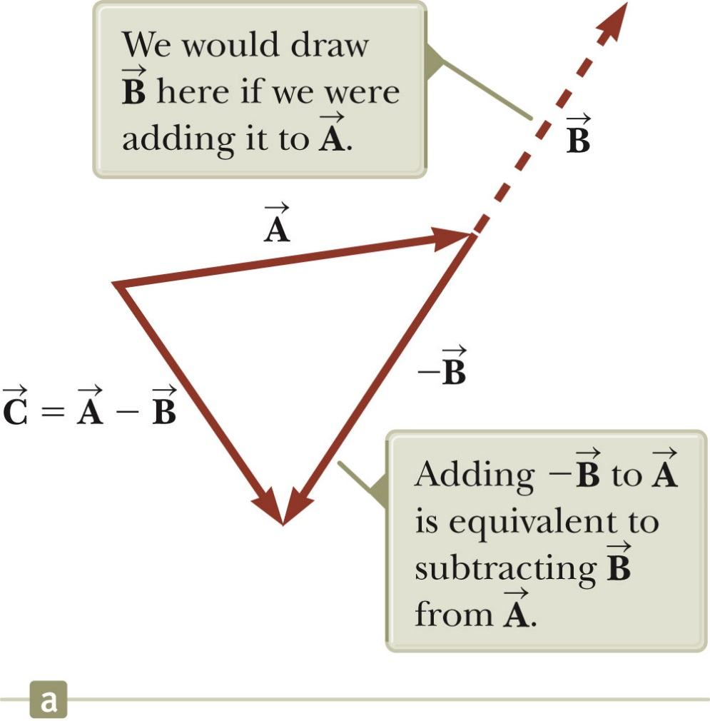
Subtracting Vectors
Special case of vector addition:
If , then use
Continue with standard vector addition procedure.

Slide 21
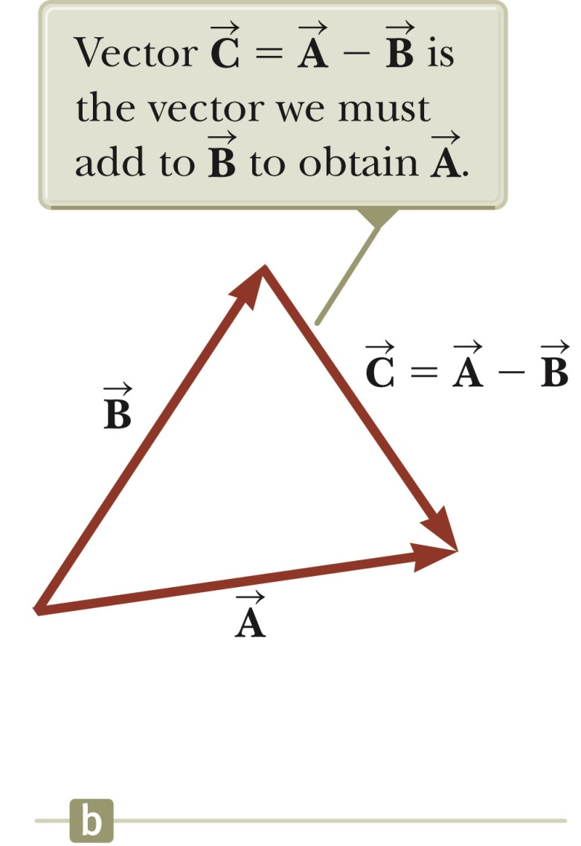
Subtracting Vectors, Method 2
Another way to look at subtraction is to find the vector that, added to the second vector gives you the first vector.
As shown, the resultant vector points from the tip of the second to the tip of the first.

Slide 22
Multiplying or Dividing a Vector by a Scalar
The result of the multiplication or division of a vector by a scalar is a vector.
The magnitude of the vector is multiplied or divided by the scalar.
If the scalar is positive, the direction of the result is the same as of the original vector.
If the scalar is negative, the direction of the result is opposite that of the original vector.

Slide 23
Component Method of Adding Vectors
Graphical addition is not recommended when:
High accuracy is required
If you have a three-dimensional problem
Component method is an alternative method
It uses projections of vectors along coordinate axes

Slide 24
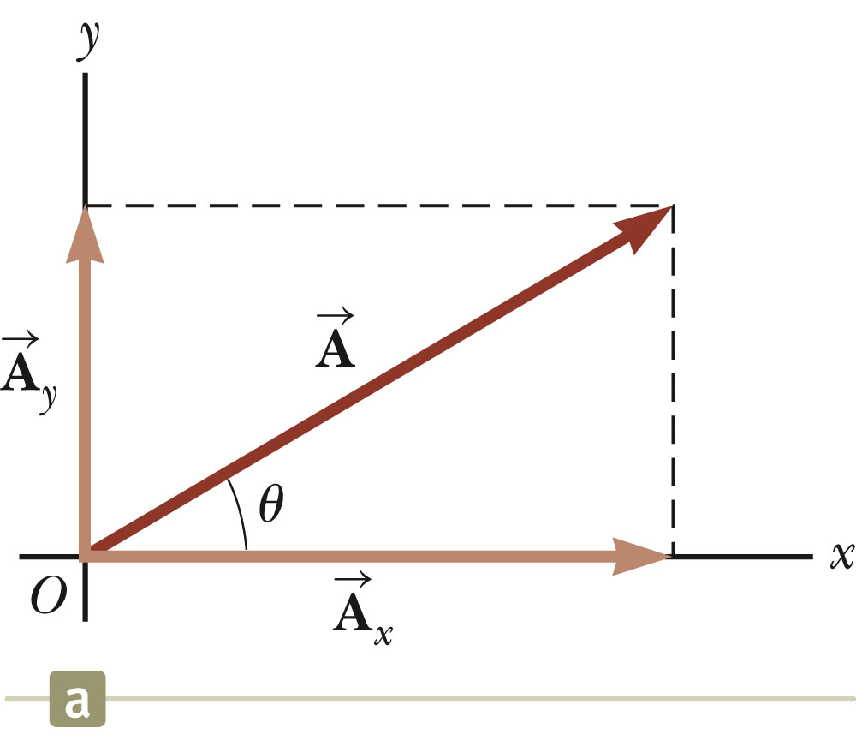
Components of a Vector, Introduction
A component is a projection of a vector along an axis.
Any vector can be completely described by its components.
It is useful to use rectangular components.
These are the projections of the vector along the x- and y-axes.

Slide 25
Vector Component Terminology
are the component vectors of .
They are vectors and follow all the rules for vectors.
A_{x} and A_{y} are scalars, and will be referred to as the components of .

Slide 26
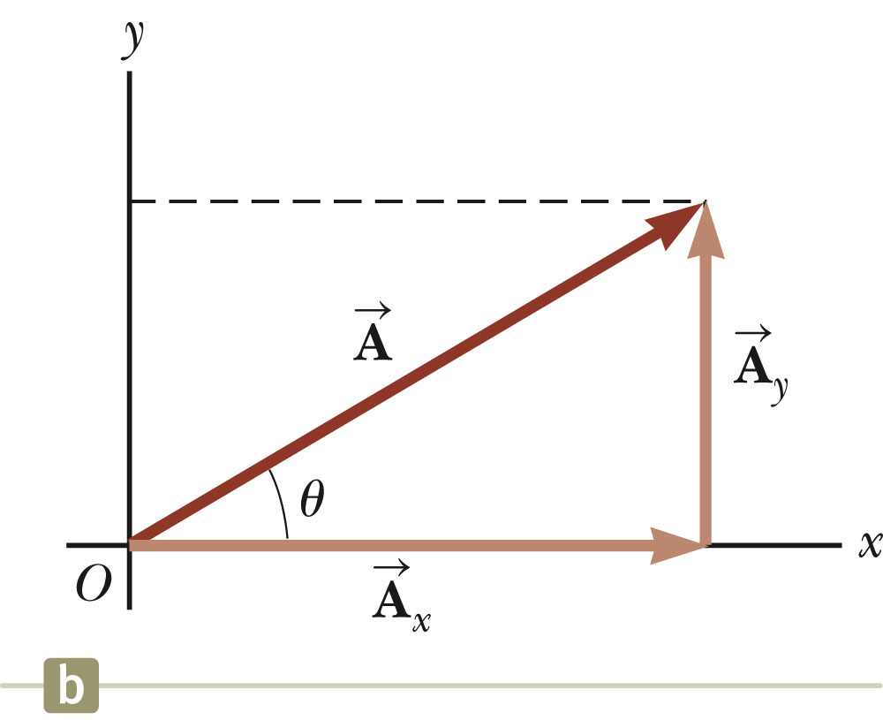
Components of a Vector
Assume you are given a vector
It can be expressed in terms of two other vectors, and
These three vectors form a right triangle.

Slide 27
Components of a Vector, 2
The y-component is moved to the end of the x-component.
This is due to the fact that any vector can be moved parallel to itself without being affected.
This completes the triangle.

Slide 28
Components of a Vector, 3
The x-component of a vector is the projection along the x-axis.
The y-component of a vector is the projection along the y-axis.
This assumes the angle θ is measured with respect to the x-axis.
If not, do not use these equations, use the sides of the triangle directly.

Slide 29
Components of a Vector, 4
The components are the legs of the right triangle whose hypotenuse is the length of A.
May still have to find θ with respect to the positive x-axis
In a problem, a vector may be specified by its components or its magnitude and direction.

Slide 30
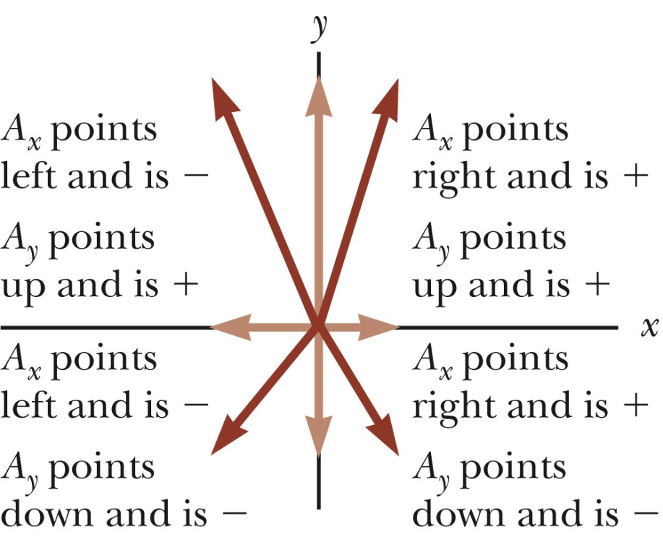
Components of a Vector, final
The components can be positive or negative and will have the same units as the original vector.
The signs of the components will depend on the angle.

Slide 31
Unit Vectors
A unit vector is a dimensionless vector with a magnitude of exactly 1.
Unit vectors are used to specify a direction and have no other physical significance.

Slide 32
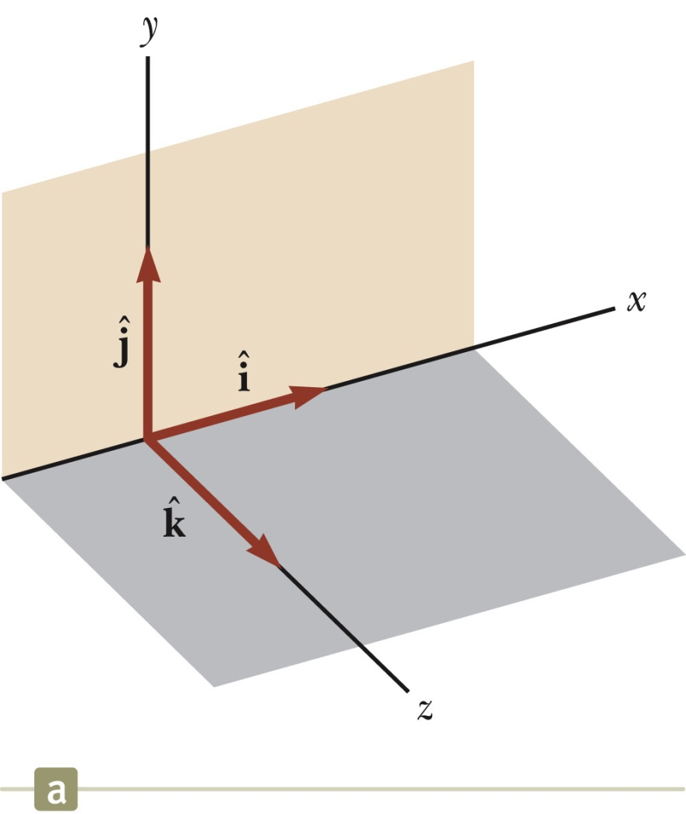
Unit Vectors, cont.
The symbols
represent unit vectors
They form a set of mutually perpendicular vectors in a right-handed coordinate system
The magnitude of each unit vector is 1

Slide 33
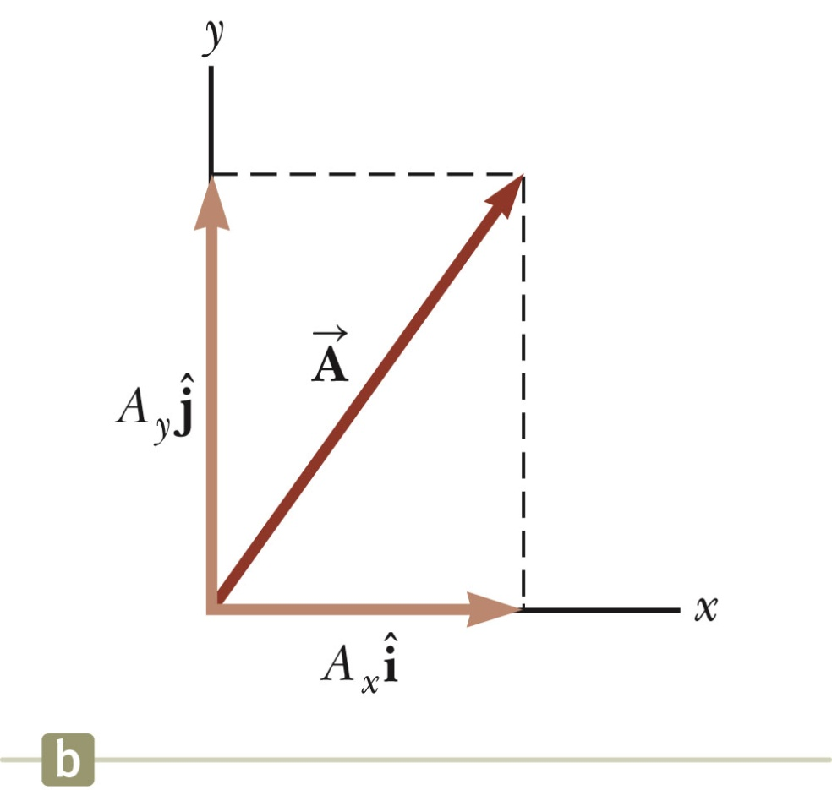
Unit Vectors in Vector Notation
A_{x} is the same as A_{x} and A_{y} is the same as A_{y} etc.
The complete vector can be expressed as:

Slide 34
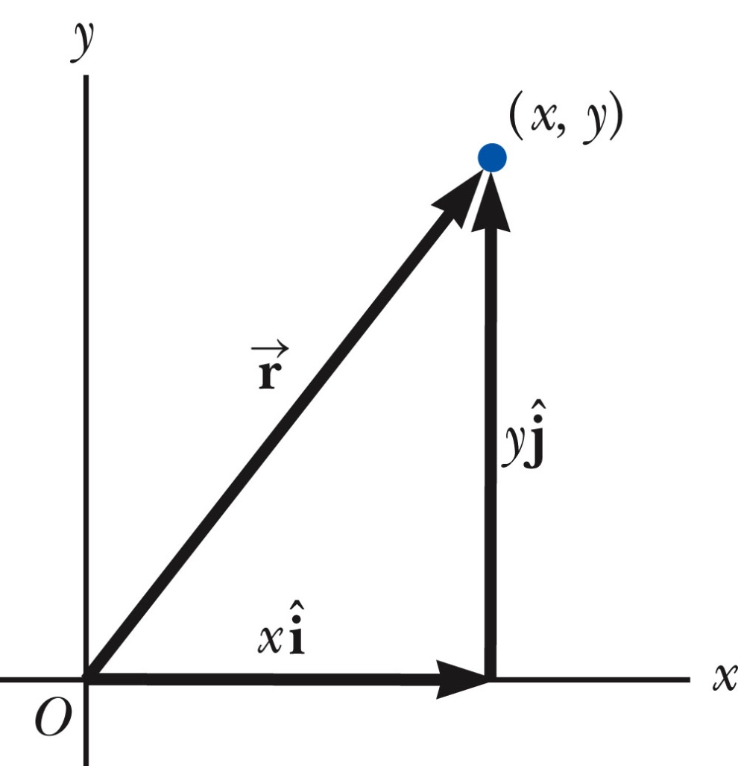
Position Vector, Example
A point lies in the xy plane and has Cartesian coordinates of (x, y).
The point can be specified by the position vector.
This gives the components of the vector and its coordinates.

Slide 35
Adding Vectors Using Unit Vectors
Using
Then
So R_{x} = A_{x} + B_{x} and R_{y} = A_{y} + B_{y}

Slide 36
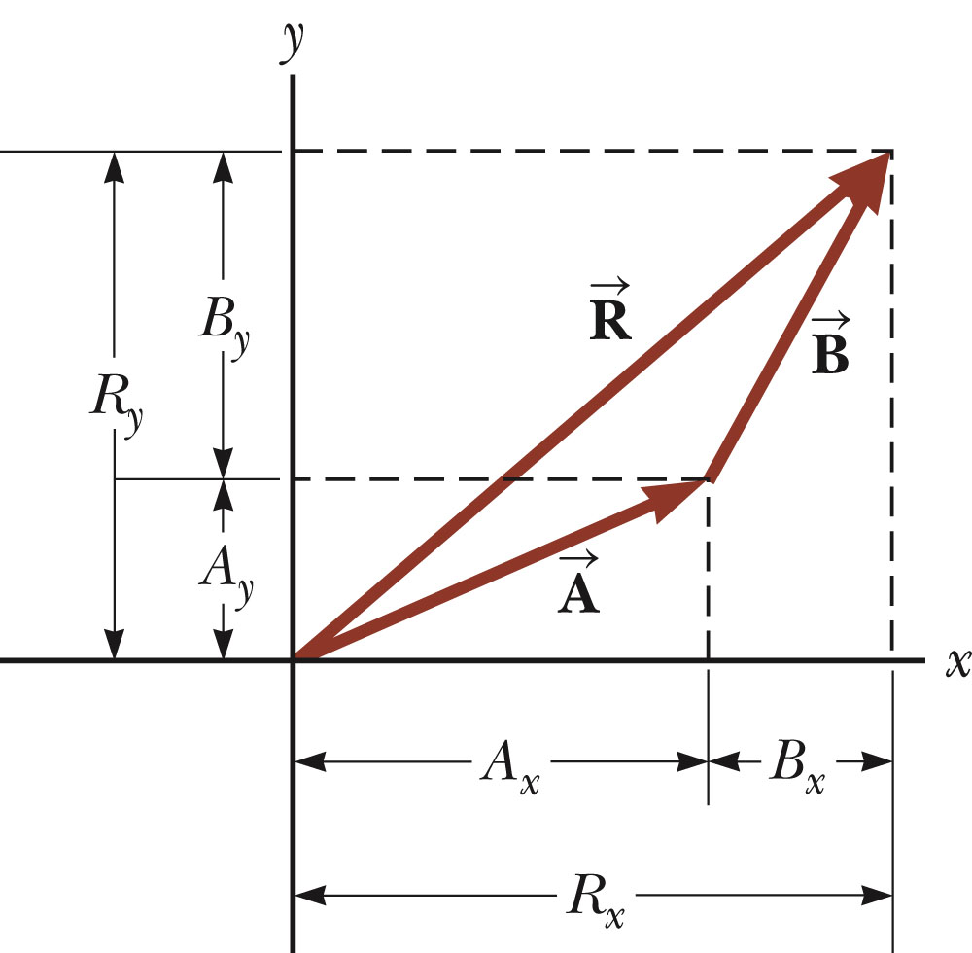
Adding Vectors with Unit Vectors
Note the relationships among the components of the resultant and the components of the original vectors.
R_{x} = A_{x} + B_{x}
R_{y} = A_{y} + B_{y}
Section 3.4

Slide 37
Three-Dimensional Extension
Using
Then
So R_{x}= A_{x}+B_{x}, R_{y}= A_{y}+B_{y}, and R_{z} = A_{z}+B_{z}

Slide 38
Adding Three or More Vectors
The same method can be extended to adding three or more vectors.
Assume
And

Slide 39
Vector Math
Vector Inverse
Just switch direction
Vector Addition
Use head-tail method, or parallelogram method
Vector Subtraction
Use inverse, then add
Vector Multiplication
Three kinds!
Multiplying a vector by a scalar
Scalar, or dot product
Vector, or cross product
Vector Math by Components

Slide 40
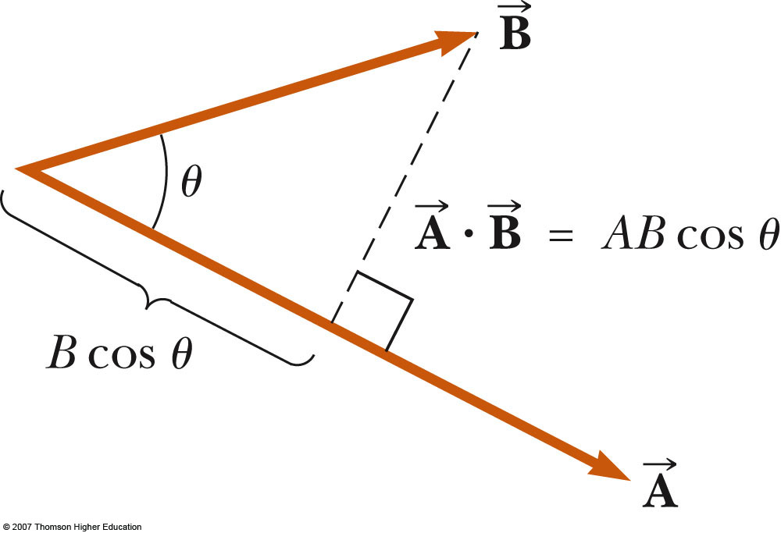
Scalar Product of Two Vectors
The scalar product of two vectors is written as
It is also called the dot product
θ is the angle between A and B
Applied to work, this means

Slide 41
Dot Product
The dot product says something about how parallel two vectors are.
The dot product (scalar product) of two vectors can be thought of as the projection of one onto the direction of the other.
Components
θ

Slide 42
Projection of a Vector: Dot Product
The dot product says something about how parallel two vectors are.
The dot product (scalar product) of two vectors can be thought of as the projection of one onto the direction of the other.
Components
Projection is zero
π/2

Slide 43
Derivation
How do we show that ?
Start with
Then
But
So

Slide 44
Example
Elastic collision

Slide 45
Cross Product
The cross product of two vectors says something about how perpendicular they are.
Magnitude:
θ is smaller angle between the vectors
Cross product of any parallel vectors = zero
Cross product is maximum for perpendicular vectors
Cross products of Cartesian unit vectors:
θ
y
j
i
x
k
z
i
j
k

Slide 46
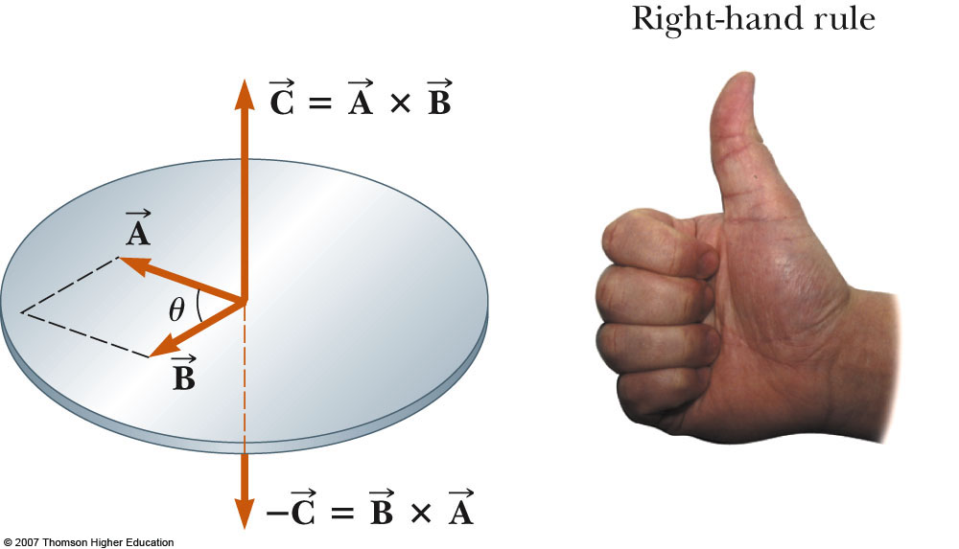
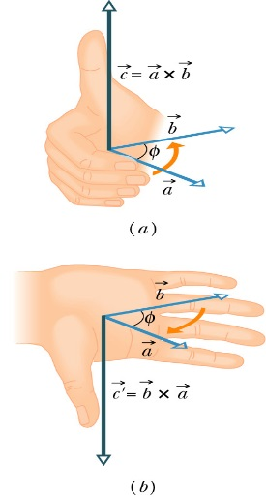
Cross Product
Direction: C perpendicular to both A and B (right-hand rule)
Place A and B tail to tail
Right hand, not left hand
Four fingers are pointed along the first vector A
“sweep” from first vector A into second vector B through the smaller angle between them
Your outstretched thumb points the direction of C
First practice

Slide 47
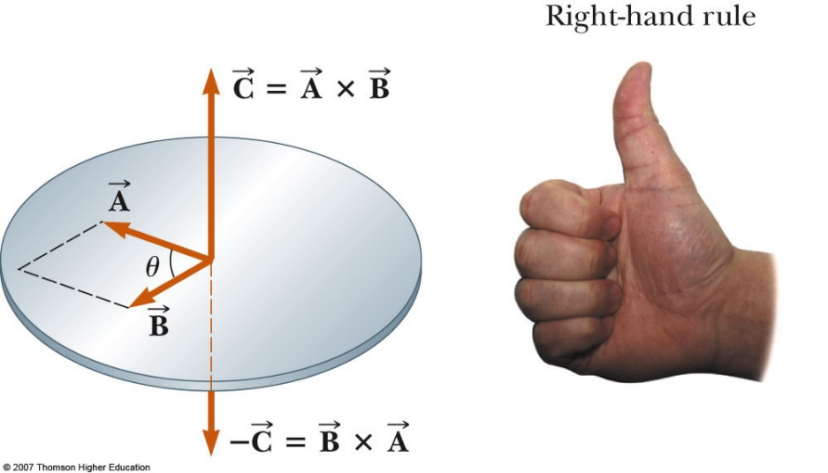
More about Cross Product
The quantity ABsinθ is the area of the parallelogram formed by A and B
The direction of C is perpendicular to the plane formed by A and B
Cross product is not commutative
The distributive law
The derivative of cross product
obeys the chain rule
Calculate cross product

Slide 48
Derivation
How do we show that ?
Start with
Then
But
So

Slide 49
CROSS PRODUCT PROPERTIES
Theorem 8
If a, b, and c are vectors and c is a scalar, then
a x b = –b x a
(ca) x b = c(a x b) = a x (cb)
a x (b + c) = a x b + a x c

Slide 50
CROSS PRODUCT PROPERTIES
Theorem 8
(a + b) x c = a x c + b x c
a · (b x c) = (a x b) · c
a x (b x c) = (a · c)b – (a · b)c

Slide 51
SCALAR TRIPLE PRODUCT
The product a . (b x c) that occurs in Property 5 is called the scalar triple product of the vectors a, b, and c.

Slide 52
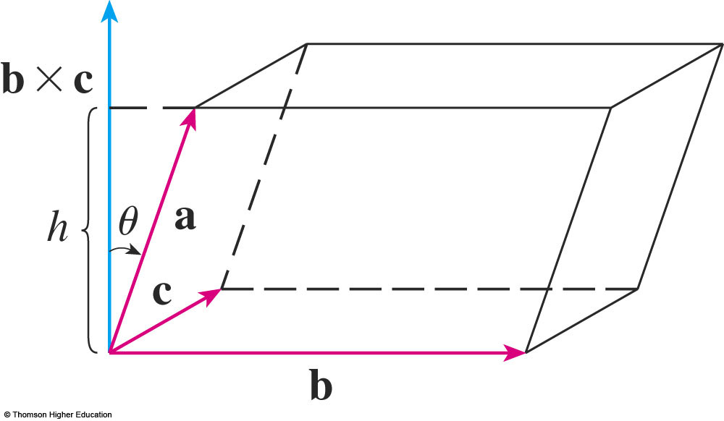
SCALAR TRIPLE PRODUCTS
The geometric significance of the scalar triple product can be seen by considering the parallelepiped determined by the vectors a, b, and c.

Slide 53
SCALAR TRIPLE PRODUCTS
The area of the base parallelogram is: A = |b x c|

Slide 54
SCALAR TRIPLE PRODUCTS
If θ is the angle between a and b x c, then the height h of the parallelepiped is: h = |a||cos θ|
We must use |cos θ| instead of cos θ in case θ > π/2.

Slide 55
SCALAR TRIPLE PRODUCTS
Hence, the volume of the parallelepiped is: V = Ah = |b x c||a||cos θ| = |a · (b x c)|
Thus, we have proved the following formula.

Slide 56
SCALAR TRIPLE PRODUCTS
Formula 11
The volume of the parallelepiped determined by the vectors a, b, and c is the magnitude of their scalar triple product:
V = |a ·(b x c)|

Slide 57
Newton’s 2nd Law
F = ma = dP/dt
rxF = rxdP/dt = d(rxP)/dt
τ = dL/dt

Slide 58
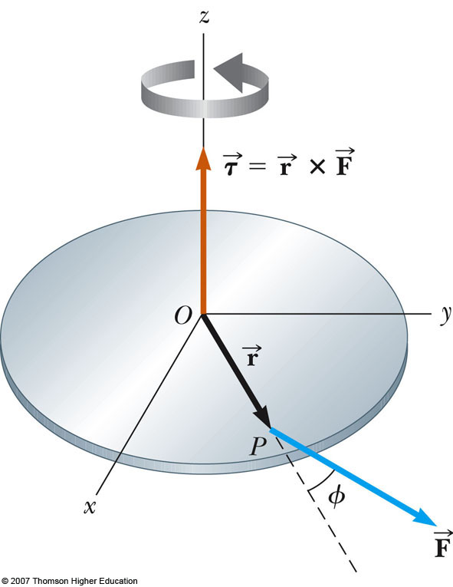
Torque as a Cross Product
The torque is the cross product of a force vector with the position vector to its point of application
The torque vector is perpendicular to the plane formed by the position vector and the force vector (e.g., imagine drawing them tail-to-tail)
Right Hand Rule: curl fingers from r to F, thumb points along torque.
Superposition:
Can have multiple forces applied at multiple points.
Direction of τ_{net} is angular acceleration axis

Slide 59
Calculating Cross Products
Find:
Where:
Solution:
i
j
k
Calculate torque given a force and its location
Solution:

Slide 60
Angular Momentum I
Angular momentum of a rotating rigid object
L has the same direction as ω
L is positive when object rotates in CCW
L is negative when object rotates in CW
Angular momentum SI unit: kgm²/s
Calculate L of a 10 kg disc when ω = 320 rad/s, R = 9 cm = 0.09 m
L = Iω and I = MR²/2 for disc
L = 1/2MR²ω = ½(10)(0.09)²(320) = 12.96 kgm²/s

Slide 61
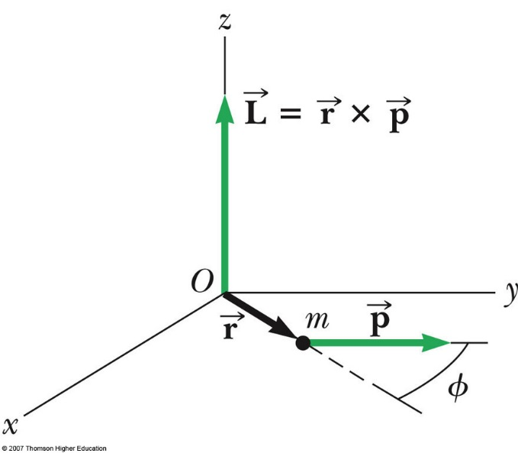
Angular Momentum II
Angular momentum of a particle
Angular momentum of a particle
r is the particle’s instantaneous position vector
p is its instantaneous linear momentum
Only tangential momentum component contribute
r and p tail to tail form a plane, L is perpendicular to this plane

Slide 62
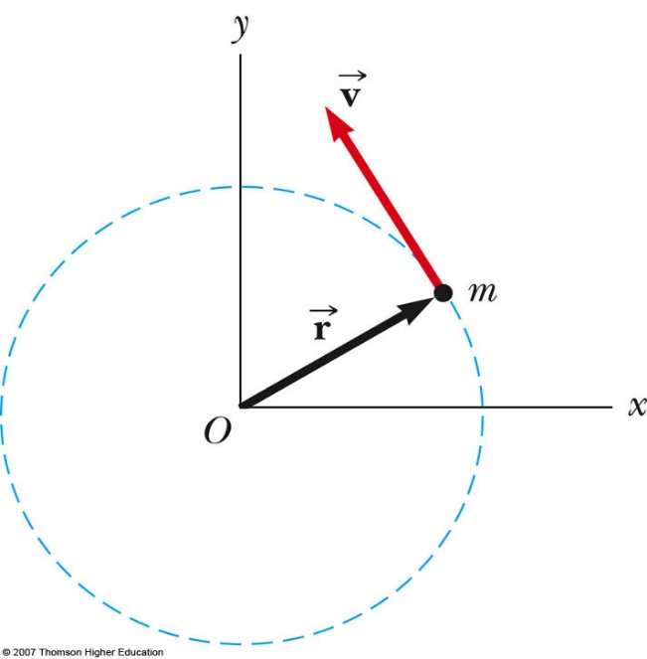
Angular Momentum of a Particle in Uniform Circular Motion
Example: A particle moves in the xy plane in a circular path of radius r. Find the magnitude and direction of its angular momentum relative to an axis through O when its velocity is v.
The angular momentum vector points out of the diagram
The magnitude is
L = rp sinθ = mvr sin (90º) = mvr
A particle in uniform circular motion has a constant angular momentum about an axis through the center of its path
O

